Slide 1
WRES2203 Advanced Network Technology
Chapter 7
Connecting to the WAN

Slide 2
Contents
Introduction
Operation
Devices
Services
Private Infrastructure
Public Infrastructure

Slide 3
Introduction
Wide-area Networks (WANs) are used to connect remote LANs together.
A WAN operates beyond the geographic scope of a LAN.
A WAN may cover a city, country, or global region.
A WAN is owned by a service provider, and a business pays a fee to use the provider’s WAN network services.
WAN service providers include carriers, such as a telephone network, cable company, or satellite service.
Service providers provide links to interconnect remote sites for the purpose of transporting data, voice, and video.

Slide 4
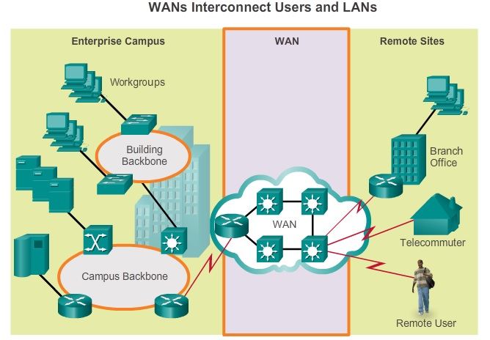
Introduction

Slide 5
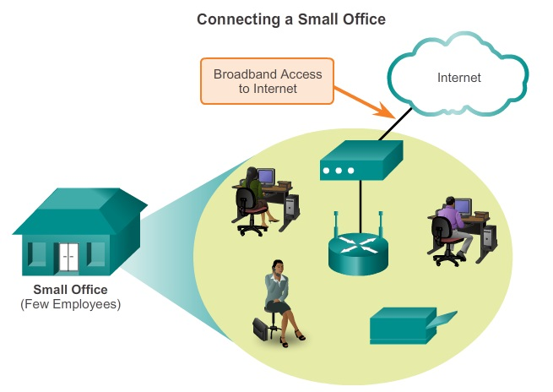
Introduction

Slide 6
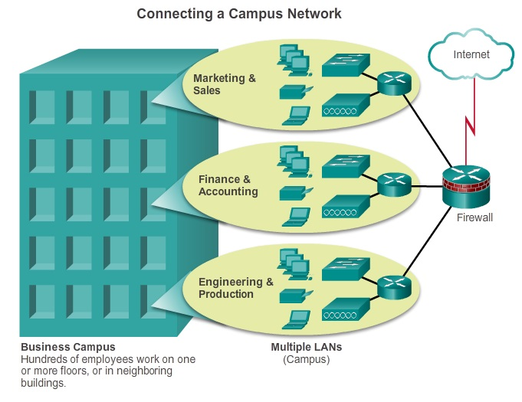
Introduction

Slide 7
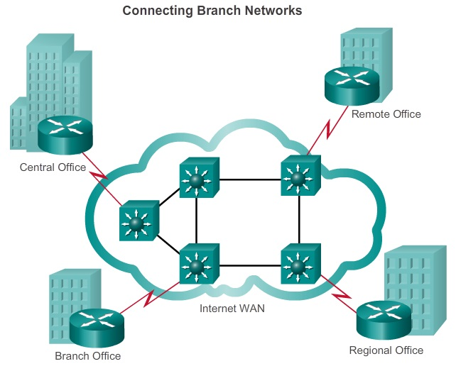
Introduction

Slide 8
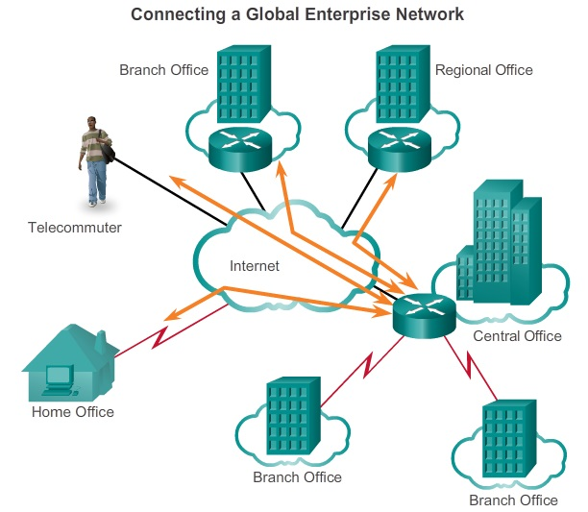
Introduction

Slide 9
Operation
WAN access standards typically describe both physical layer delivery methods and data link layer requirements, including physical addressing, flow control, and encapsulation.
The authorities:
  Telecommunication Industry Association and the Electronic Industries Alliance (TIA/EIA)
  International Organization for Standardization (ISO)
  Institute of Electrical and Electronics Engineers (IEEE)

Slide 10
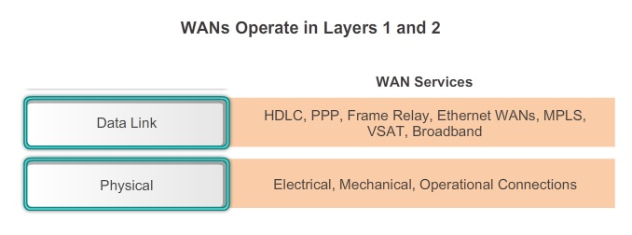
Operation

Slide 11
Operation
The physical layer of a WAN describes the physical connections between the company network and the service provider network.
Customer Premises Equipment (CPE)
  The devices and inside wiring located on the enterprise edge connecting to a carrier link. The subscriber either owns the CPE or leases the CPE from the service provider.
Data Communications Equipment (DCE)
  Also called data circuit-terminating equipment
  Put data on the local loop. Connect subscribers to a communication link on the WAN cloud.

Slide 12
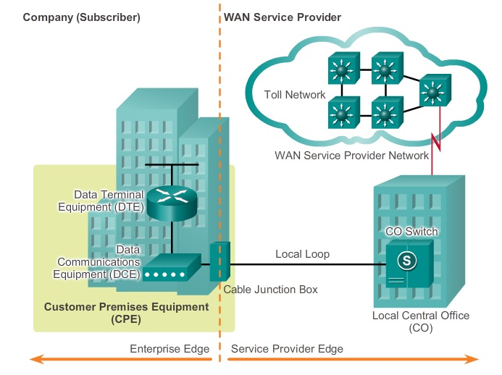
Operation

Slide 13
Operation
Data Terminal Equipment (DTE)
  Pass the data from a customer network or host computer for transmission over the WAN. The DTE connects to the local loop through the DCE.
Demarcation Point
  A point established in a building or complex to separate customer equipment from service provider equipment.
  Connects the CPE wiring to the local loop.
Local Loop
  The actual copper or fiber cable that connects the CPE to the CO of the service provider.

Slide 14
Operation
Central Office (CO)
  The local service provider facility or building that connects the CPE to the provider network.
Toll network
  This consists of the long-haul, all-digital, fiber-optic communications lines, switches, routers, and other equipment inside the WAN provider network.

Slide 15
Devices
Dialup modem
  Legacy WAN technology, a voice-band modem converts the digital signals produced by a computer into voice frequencies that can be transmitted over the analog lines of the public telephone network.
  On the other side of the connection, another modem converts the sounds back into a digital signal for input to a computer or network connection.
Access server
  Concentrates dialup modem, dial-in and dial-out user communications

Slide 16
Devices
Broadband modem
  A type of digital modem used with high-speed DSL or cable Internet service.
CSU/DSU
  Digital-leased lines require a CSU and a DSU.
  The CSU provides termination for the digital signal and ensures connection integrity through error correction and line monitoring.
  The DSU converts the line frames into frames that the LAN can interpret and vice versa.

Slide 17
Devices
WAN switch
  A multiport internetworking device used in service provider networks. Example, Frame Relay or ATM and operate at Layer 2.
Router
  Provides internetworking and WAN access interface ports that are used to connect to the service provider network.
  These interfaces may be serial connections, Ethernet, or other WAN interfaces.
Core router/Multilayer switch
  A router or multilayer switch that resides within the middle or backbone of the WAN

Slide 18
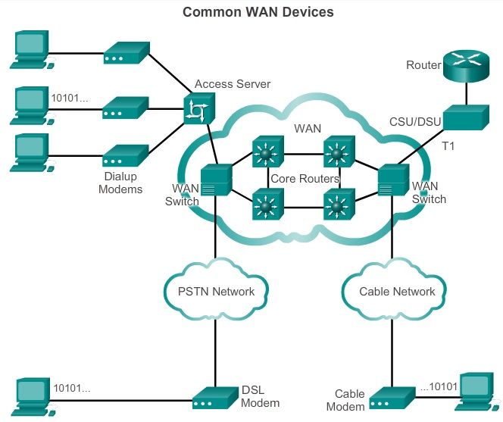
Devices

Slide 19
Devices
WAN technologies are either circuit-switched or packet-switched.
Circuit-switched network is one that establishes a dedicated circuit (or channel) between nodes and terminals before the users may communicate.
Specifically, circuit switching dynamically establishes a dedicated virtual connection for voice or data between a sender and a receiver. As an example, when a subscriber makes a telephone call.
Two most common types of circuit-switched WAN technologies are the Public Switched Telephone Network (PSTN) and the Integrated Services Digital Network (ISDN).

Slide 20
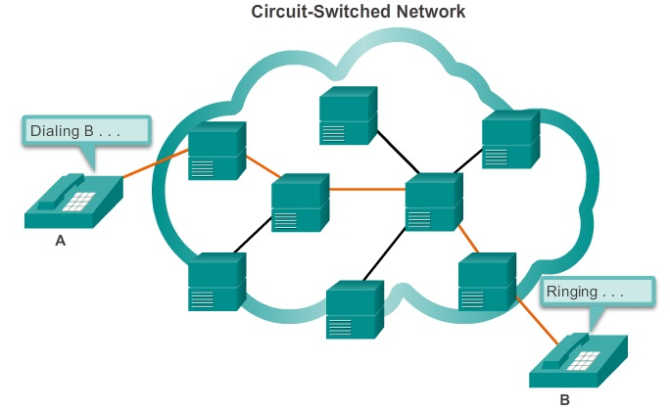
Devices

Slide 21
Devices
Packet switching splits traffic data into packets that are routed over a shared network. Packet-switching networks do not require a circuit to be established, and they allow many pairs of nodes to communicate over the same channel.
Two approaches of link determination:
  Connectionless systems
    Full addressing information must be carried in each packet. Each switch must evaluate the address to determine where to send the packet. An example of a connectionless system is the Internet.

Slide 22
Devices
  Connection-oriented systems
    The network predetermines the route for a packet, and each packet only has to carry an identifier.
    The switch determines the onward route by looking up the identifier in tables held in memory.
    The set of entries in the tables identifies a particular route or circuit through the system.
    An example of a connection-oriented system is Frame Relay.

Slide 23
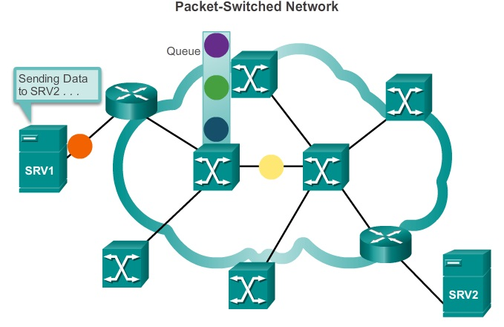
Devices

Slide 24
Services
Private WAN Infrastructure
  May consist of dedicated point-to-point leased lines, circuit-switched links, such as PSTN or ISDN, and packet-switched links, such as Ethernet WAN, ATM, or Frame Relay.
Public WAN infrastructure
  May offer broadband Internet access using Digital Subscriber Line (DSL), cable, and satellite access.
  Broadband connection options are typically used to connect small offices and telecommuting employees to a corporate site over the Internet.
  Data travelling between corporate sites over the public WAN infrastructure should be protected using VPNs.

Slide 25
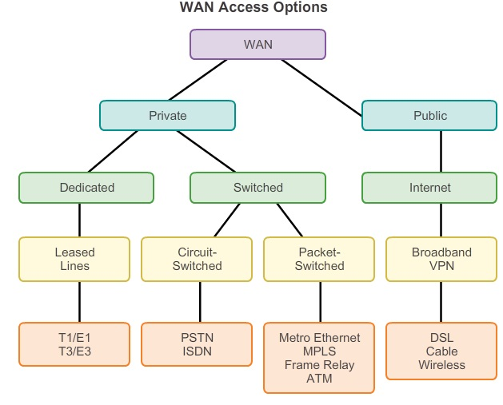
Services

Slide 26
Services
Service provider networks are complex. The network consist mostly of high-bandwidth fiber optic media, using either the Synchronous Optical Networking (SONET) or Synchronous Digital Hierarchy (SDH) standard.
These standards define how to transfer multiple data, voice, and video traffic over optical fiber using lasers or Light-Emitting Diodes (LEDs) over great distances.
Dense Wavelength Division Multiplexing (DWDM) is used for the long-range communications or fiber optic media development.

Slide 27
Services
DWDM:
  Enables bidirectional communications over one strand of fiber.
  Can multiplex more than 80 different channels of data (i.e., wavelengths) onto a single fiber.
  Each channel is capable of carrying a 10 Gb/s multiplexed signal.
  Assigns incoming optical signals to specific wavelengths of light (i.e., frequencies).
  Can amplify these wavelengths to boost the signal strength.
  Supports SONET and SDH standards.

Slide 28
Private Infrastructure
Leased Line
  Point-to-point lines leased from a service provider.
  Also referred to by different names such as leased circuits, serial link, serial line, point-to-point link, and T1/E1 or T3/E3 lines.
  Available in different capacities and are generally priced based on the bandwidth required and the distance between the two connected points.
  North America uses the T-carrier system, while Europe uses the E-carrier system.
  Advantages: simplicity, quality and availability
  Disadvantages: cost, limited flexibility

Slide 29
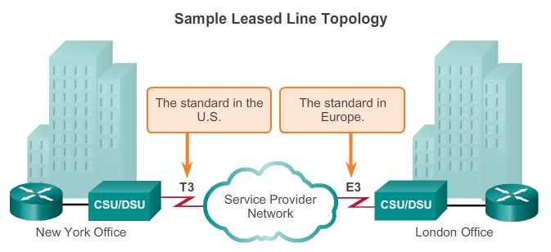
Private Infrastructure

Slide 30
Private Infrastructure
Dialup WAN
  A remote location could use a modem and analog dialed telephone lines to provide low capacity and dedicated switched connections.
  The advantages of modem and analog lines are simplicity, availability, and low implementation cost.
  The disadvantages are the low data rates and a relatively long connection time.

Slide 31
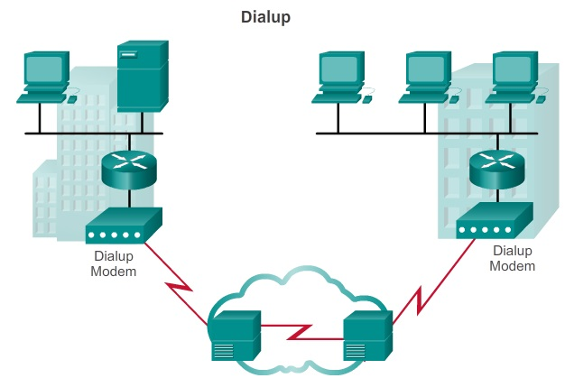
Private Infrastructure

Slide 32
Private Infrastructure
Integrated Services Digital Network (ISDN)
  A circuit-switching technology that enables the local loop of a PSTN to carry digital signals, resulting in higher capacity switched connections.
  Using Time-Division Multiplexed (TDM) digital signals.
  May require a Terminal Adapter (TA) which is a device used to connect ISDN Basic Rate Interface (BRI) connections to a router.
  ISDN is also used as a backup if the leased line fails.

Slide 33
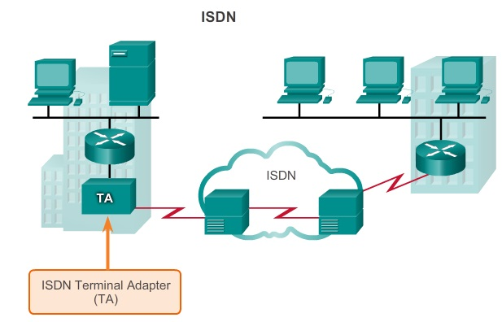
Private Infrastructure

Slide 34
Private Infrastructure
Two types of ISDN interfaces
Basic Rate Interface (BRI)
  For the home and small enterprise and provides two 64 kb/s B channels and a 16 kb/s D channel.
Primary Rate Interface (PRI)
  Delivers 23 B channels with 64 kb/s and one D channel with 64 kb/s for a total bit rate of up to 1.544 Mb/s.

Slide 35
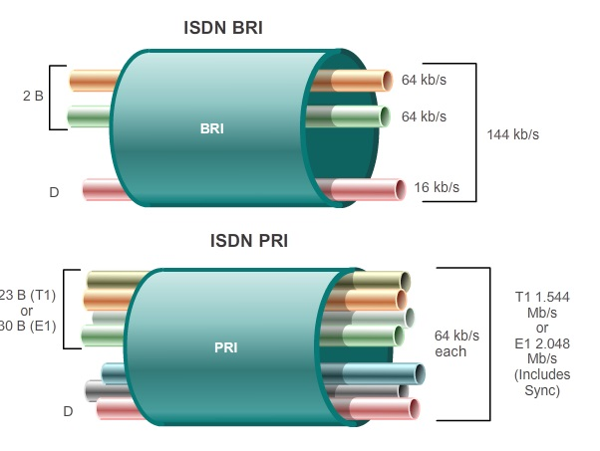
Private Infrastructure

Slide 36
Private Infrastructure
Frame Relay
  A simple Layer 2 non-broadcast multi-access (NBMA) WAN technology used to interconnect enterprise LANs.
  A single router interface can be used to connect to multiple sites using PVCs.
  PVCs are used to carry both voice and data traffic between a source and destination, and support data rates up to 4 Mb/s.
  PVCs are uniquely identified by a data-link connection identifier (DLCI).

Slide 37
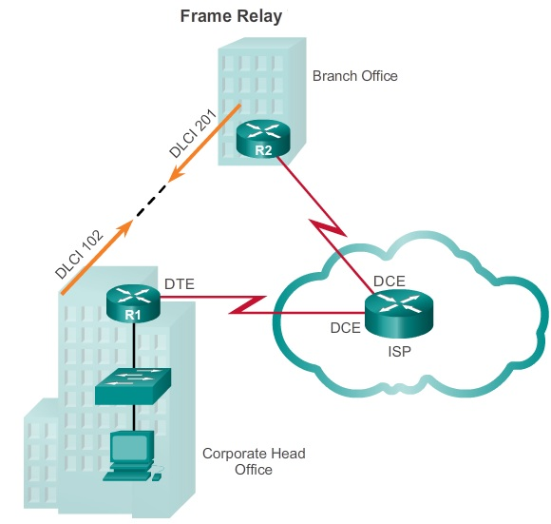
Private Infrastructure

Slide 38
Private Infrastructure
Asynchronous Transfer Mode (ATM)
  Capable of transferring voice, video, and data through private and public networks.
  It is built on a cell-based architecture. The cells are always a fixed length of 53 bytes. The ATM cell contains a 5-byte ATM header followed by 48 bytes of ATM payload.
  Allows multiple VCs on a single leased-line connection to the network edge.

Slide 39
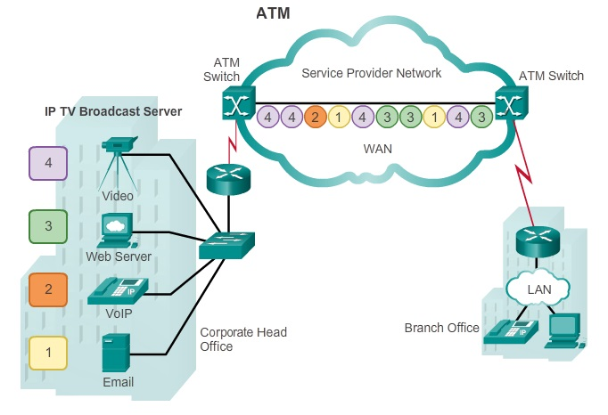
Private Infrastructure

Slide 40
Private Infrastructure
Ethernet WAN
  Using fiber optic cabling.
  Example, IEEE 1000BASE-LX standard supports fiber optic cable lengths of 5 km, while the IEEE 1000BASE-ZX standard supports up to 70 km cable lengths.
  The Ethernet WAN service can go by many names, including Metropolitan Ethernet (MetroE), Ethernet over MPLS (EoMPLS), and Virtual Private LAN Service (VPLS).

Slide 41
Private Infrastructure
Ethernet WAN Advantages
  Reduced expenses and administration
    Increases bandwidth and eliminates expensive conversions to other WAN technologies.
  Easy integration with existing networks
    Connects easily to existing Ethernet LANs, reducing installation costs and time.
  Enhanced business productivity

Slide 42
Private Infrastructure
Multiprotocol Label Switching (MPLS)
  Multiprotocol high-performance WAN technology that directs data from one router to the next, based on short path labels
  The labels identify paths between distant routers rather than endpoints, and while MPLS actually routes IPv4 and IPv6 packets, everything else is switched.
  MPLS can deliver any type of packet between sites. MPLS can encapsulate packets of various network protocols. It supports a wide range of WAN technologies including T-carrier / E-carrier links, Carrier Ethernet, ATM, Frame Relay, and DSL.

Slide 43
Private Infrastructure
Very Small Aperture Terminal (VSAT)
  Creates a private WAN using satellite communications.
  A VSAT is a small satellite dish similar to those used for home Internet and TV.
  Specifically, a router connects to a satellite dish which is pointed to a service provider’s satellite in a geosynchronous orbit in space. The signals must travel approximately 35,786 kilometers (22,236 miles) to the satellite and back.

Slide 44
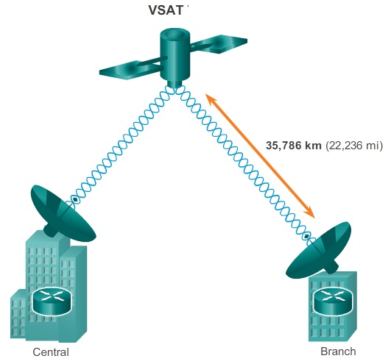
Private Infrastructure

Slide 45
Public Infrastructure
DSL
  An always-on connection technology that uses existing twisted-pair telephone lines to transport high-bandwidth data, and provides IP services to subscribers.
  A DSL modem converts an Ethernet signal from the user device to a DSL signal, which is transmitted to the central office.
  Multiple DSL subscriber lines are multiplexed into a single, high-capacity link using a DSL Access Multiplexer (DSLAM) at the provider location.

Slide 46
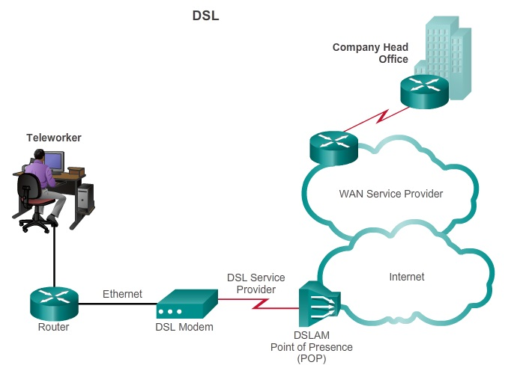
Public Infrastructure

Slide 47
Public Infrastructure
Coaxial Cable
  Widely used in urban areas to distribute television signals. Network access is available from many cable television providers.
  Provide an always-on connection and a simple installation.
  Cable modem translates the digital signals into the broadband frequencies used for transmitting on a cable television network.
  The Cable Modem Termination System (CMTS) provides Internet services to cable subscribers.

Slide 48
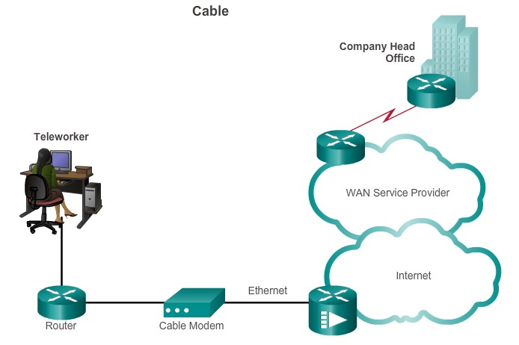
Public Infrastructure

Slide 49
Public Infrastructure
Municipal Wi-Fi
  Many cities have begun setting up municipal wireless networks.
  To connect to a municipal Wi-Fi, a subscriber typically needs a wireless modem, which provides a stronger radio and directional antenna than conventional wireless adapters.
Worldwide Interoperability for Microwave Access (WiMAX)
  Provides high-speed broadband service with wireless access and provides broad coverage like a cell phone network rather than through small Wi-Fi hotspots and for a greater number of users.

Slide 50
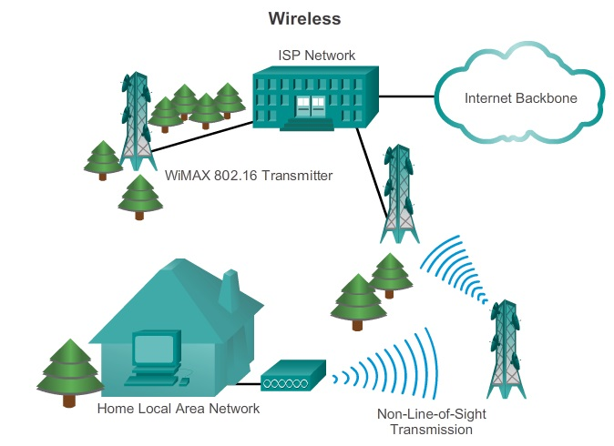
Public Infrastructure

Slide 51
Public Infrastructure
Satellite Internet
  Typically used by rural users where cable and DSL are not available.
  A VSAT provides two-way (upload and download) data communications.
  The upload speed is about one-tenth of the 500 kb/s download speed.

Slide 52
Public Infrastructure
Cellular service is another wireless WAN technology being used to connect users and remote locations where no other WAN access technology is available.
Common cellular industry terms include:
  3G/4G Wireless
    3rd generation and 4th generation cellular access.
  Long-Term Evolution (LTE)
    Newer and faster technology and is considered to be part of fourth generation (4G) technology.

Slide 53
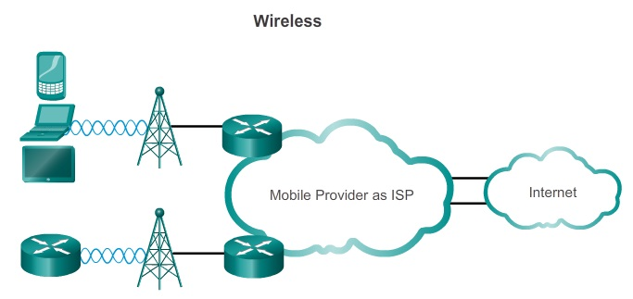
Public Infrastructure

Slide 54
Public Infrastructure
To address security concerns, broadband services provide capabilities for using VPN connections to a VPN server.
A VPN is an encrypted connection between private networks over a public network, such as the Internet.
VPN uses virtual connections called VPN tunnels, which are routed through the Internet from the private network of the company to the remote site or employee host.
Benefits of VPN include cost savings, security, scalability, and Compatible with broadband technology.

Slide 55
Public Infrastructure
There are two types of VPN access:
  Site-to-site VPNs
    Connect entire networks to each other; for example, they can connect a branch office network to a company headquarters network
    Each site is equipped with a VPN gateway, such as a router, firewall, VPN concentrator, or security appliance.
  Remote-access VPNs
    Enable individual hosts, such as telecommuters, mobile users, and extranet consumers, to access a company network securely over the Internet.

Slide 56
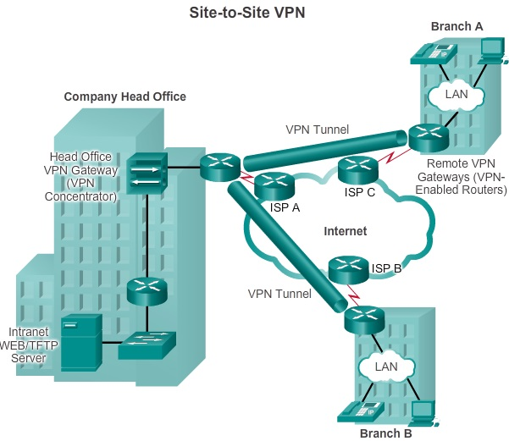
Public Infrastructure

Slide 57
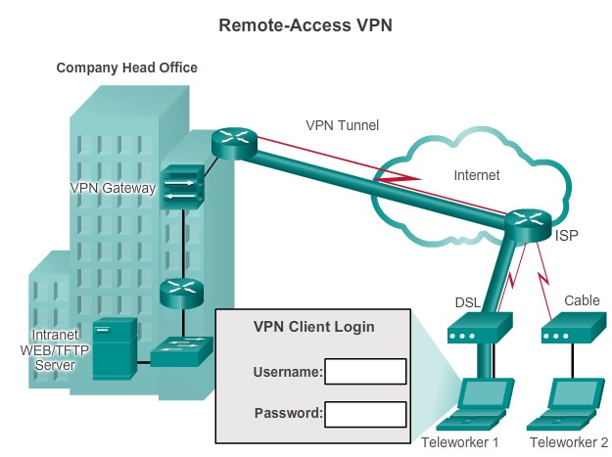
Public Infrastructure

